Slide 1
C++ Programming Today 2nd Edition By Barbara Johnston Chapter 4
Instructor: Rob Garner
Lecture Slides by Kelly Montoya and Rob Garner

Slide 2
Overview
Basic Function Characteristics
Types of functions
Calling and Called Functions
How to write functions
Return Statement
Function Calls
Function variables
Troubleshooting Functions
Overloaded Functions
Default Parameter Lists
Variable Scope
Multi-File Programs
String Stream Class
Common Errors With Functions

Slide 3
Overloaded Functions
Explain the purpose of and how to overload functions.

Slide 4
Overloaded Functions
Overloaded functions make it possible to have two or more functions with the same name but with different input parameter lists.
Overloaded functions all have perform essentially the same job—but there are different input possibilities.
Overloaded functions give us several possible functions, and due to some condition, we don’t necessarily use all of them.
Notes:
Program 4-6

Slide 5
Saying Goodnight Four Ways
Four different prototypes, same function name, all write a “goodnight” message.
The function that is used depends on what is passed to it.
void SayGoodnight();
void SayGoodnight(string name1);
void SayGoodnight(string name1, string name2);
void SayGoodnight(int number);
Notes:
. In Program 4-6 we have four functions that are all named SayGoodnight. The task for these functions is to say goodnight, but in slightly different ways. Notice how we have four different prototypes and four separate functions.

Slide 6
Write the prototypes for two overloaded functions called MultipleChars. Both will return a string. The first overload will take two parameters: a char called charToRepeat and an int called numChars. The second overloaded function will take one parameter, an int called numChars.

Slide 7
Default Parameter Lists
Explain how to use and the purpose of default parameter lists.

Slide 8
Default Input Parameter List Functions
The default input parameter list allows the program to declare a function that has a variable number of input parameters.
The programmer supplies the default values for the inputs.
If the function is called and the values are not passed to it, the function simply uses the default values supplied in the declaration.

Slide 9
Default Input Parameter List Functions
The prototype for this type of function may or may not contain the variable name, but the default value must be supplied.
Default parameter list functions require the programmer to pass inputs in the declaration order.
Starting with the rightmost value, parameters may be omitted from the call.
The function must be called with input values starting on the left, and input values may not be skipped.

Slide 10
Default Input Parameter List Functions
In the DrawLines program, a default parameter list is declared for a function that prints lines of characters to the screen.
The function’s job is to draw a given number of lines that are a certain length, with a given symbol.
When the function is called, it needs to know how many lines, what is the symbol, and how many symbols on each line.
Notes:
Program 4-7, the DrawLines program.

Slide 11
Default Input Parameter List Functions
We set up the default values:
a percent sign ‘%’ for the symbol
twenty-five characters on a line
the default number of lines is one
The function prototype is:
void DrawLines(char symbol = ‘%’,
int numOfSymbols = 25,
int numOfLines = 1 );

Slide 12
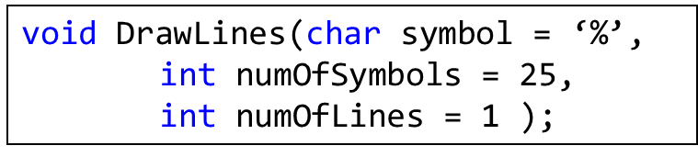
Default Input Parameter List Functions
Call the function in the following four ways:
DrawLines(); //no inputs, default values are used
DrawLines(‘@’, 30); //use @, 30 chars, default 1 line
DrawLines(‘#’,15,3); //passing in all input values
DrawLines(‘%’,6); //vary the second value,
//must have the first

Slide 13
Output of the DrawLines program.
Default Line 25 % on 1 line
%%%%%%%%%%%%%%%%%%%%%%%%%
Change to 30 @ on 1 line
@@@@@@@@@@@@@@@@@@@@@@@@@@@@@@
Now draw 15 # on 3 lines
###############
###############
###############
Last line has 6 % on 1 line
%%%%%%
No more lines for you.

Slide 14
Write the prototype of a function called MultipleChars that returns a string and takes two parameters: a char called charToRepeat that defaults to ‘*’ and an int called numChars.

Slide 15
Variable Scope
Explain variable scope and how to use and purpose of local, global and static variables.

Slide 16
Local, Global and Static Variables
Variable scope determines which variables in the program are visible to other portions of the program and dictates “how long” a variable is available while the program is executing.
This variable visibility issue includes the ability for one portion of the code to access a variable in other parts of the code.
The scope of the variable is determined by the location where the variable is declared.

Slide 17
Local Variables
The variables declared within the function and in the function header line input list belong to that function.
No other function can see, access, or change these variables.
These local variables come into existence when the function begins executing and are destroyed once program control exits the function.
Also known as Automatic variables.

Slide 18
Block Scope
When you declare a variable inside a set of braces { } that variable then exists inside that block of code.
Once code execution moves beyond those braces, the variable goes out of scope.
It also shows the regions where the variables are in scope.

Slide 19
A program illustrating local and global variables.
The name variable is global and all functions can see it.

Slide 20
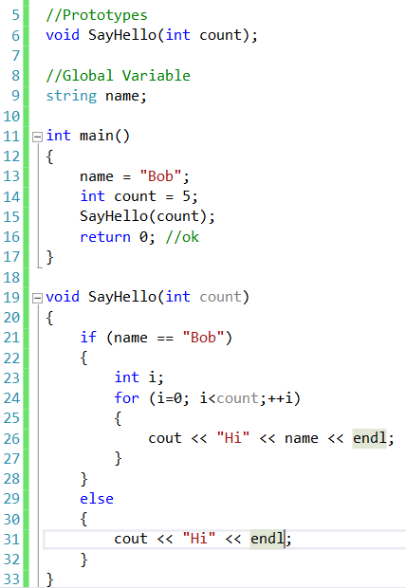
name
Bob
count
5
5
count
i
1
2
3
4
0
5
Hi bob
Hi bob
Hi bob
Hi bob
Hi bob

Slide 21
Global Variables
A global variable is declared outside any function and is visible to all functions in that program file.
All the functions can use and change a global variable.
Global variables are declared above main().
There is no need to pass them between functions.
Notes:
Program 4-8 uses global variables.

Slide 22
Global Variables
global variables declared outside functions
int age;
string name;
int main()
{
WriteHello(); //Write a greeting
AskForName(); //Ask for the user's name
AskForAge(); //Ask for age
Write(); //Write information
return 0;
}
All functions in this file can see these. No need to pass between functions
Notes:
Taken from Program 4-8

Slide 23
Global Variables
Functions do not pass or return anything
since they are working with global variables.
//Function Prototypes
void WriteHello();
void AskForName();
void AskForAge();
void Write();

Slide 24
Function definitions
//AskForAge asks the user for age, returns age.
void AskForAge()
{
cout << "\n How old are you? ";
cin >> age;
cin.ignore(); //remove enter key
}
//AskForName asks the user's name
void AskForName()
{
cout << "\n What is your name? ";
getline(cin,name);
}

Slide 25
Global Variables Are Hazardous
Global variables should be used sparingly and with considerable thought as well as subsequent documentation.
As a general rule, global variables can be used for mathematical constants or universally used values and perhaps file pointers or stream objects.
If the program is quite large, with many user-written libraries, it is best to avoid global declarations altogether.
Notes:
Program 4-9 illustrates what bad things can happen with global variables.

Slide 26
Static Variables
Once a variable is declared a static variable, the variable contents are retained until the program is terminated.
The variable is still visible only to the function and it is not seen by any other parts of the program.
The first time the function is entered, the static variable initialization occurs.
Notes:
Program 4-10 demonstrates static variables.

Slide 27
Static Variables
If there is no initial value assigned in the code, C++ initializes the static variable to zero.
The static variable initialization statement is performed only once while the program is running.
If a function must “remember” a value, even after the program control has left that function, a static variable will keep its value until the program ceases to run.
The format is:
static float total = static_cast<float>;
Notes:
Program 4-10 shows how to use static variables.

Slide 28
Static Variables
float HowMuchHaveYouSpent()
{
//total is set to zero 1st time in here
static float total = static_cast<float>(0.0);
float amount;
cout << "\n How much was this recent purchase? $ ";
cin >> amount;
cin.ignore();
//keep a running total of the purchases
total = total + amount;
return total;
}
In this example, only this function sees total. Every time it is called,
it remembers the value and keeps adding it to the previous total.
Notes:
Taken from Program 4-10.

Slide 29
Variables declared in a function have which of the following scopes:
Global scope, accessible throughout the program
Local scope, accessible only in that function

Slide 30
When should you use global variables:
Always, then I don’t have to worry about access.
Never, it’s always a mistake.
Sparingly and with considerable thought as well as subsequent documentation.
None of the above.

Slide 31
Overloaded Functions Demo
Demonstrate how to overload functions.

Slide 32
Overview
Basic Function Characteristics
Types of functions
Calling and Called Functions
How to write functions
Return Statement
Function Calls
Function variables
Troubleshooting Functions
Overloaded Functions
Default Parameter Lists
Variable Scope
Multi-File Programs
String Stream Class
Common Errors With Functions

